Slide 1
Machine Learning Mini-Project
Prediction and Analysis of Degree of Suicidal Ideation in Online Content
by Noah C. Jones B.Sc., Morehouse College (2017)
Submitted to the Program in Media Arts and Sciences, School of Architecture and Planning in partial fulfillment of the requirements for the degree of Master of Science at the MASSACHUSETTS INSTITUTE OF TECHNOLOGY June 20220
Team Members:
Rajswi Lochan(1806095)
Prince Sinha(1806132)
Parth Sharma(1806172)

Slide 2
Data Collection
For this project we had used Reddit’s API to collect posts from two subreddits: “r/depression” and “r/Suicidewatch”
We aim to automate as much of this process as possible into neat functions to enable repeatability on data collection front
When collecting data from servers , we had created a randomized delay between requests as a consideration to Reddit’s servers and security staff.
We had used functions to automate the Data Collection process
In the thesis authors had used University of Maryland Suicide Risk Dataset provided to them by the Shared Task Organizers from CLPsych.
Since they provide dataset to only those who are participating in the event. So, we had collected the data from source mentioned (posts from subreddits). They had also collected from same source.

Slide 3
Data Cleaning , Pre-processing and EDA(Exploratory Data Analysis)
Both the Subreddit’s dataset have 100 columns. We had chosen only relevant features for our models.
Text data in the both the title and post itself can potentially serve our classifier well
The author’s name and the number of comments are curveball choices. There just might be a connection between a user’s handle and his/her psyche. There also might be a connection between the number of comments made.
Url: Here url in for reference. In case if we would want to look deeper into a particular post.
Finally , we’ve picked five columns that could help in our EDA , looking at all columns of r/suicidewatch(Shape:994,6) and r/depression(Shape:988,6)
title | selftext | author | num_comments | is_suicide | url
0 | Our most-broken and least-understood rules is ... | We understand that most people who reply immed... | SQLwitch | 175 | 0 | https://www.reddit.com/r/depression/comments/d.
After selection of relevant features , we had concatenated the selected parts of both dataset before cleaning.
We got combined dataset(Shape:1982 rows * 6 columns)

Slide 4
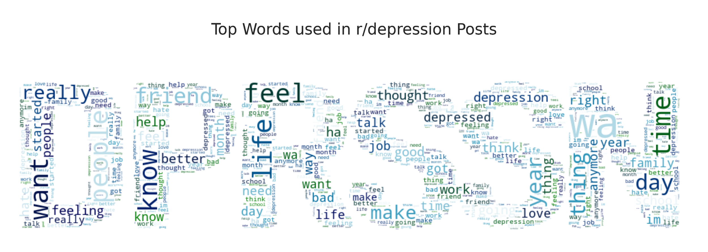
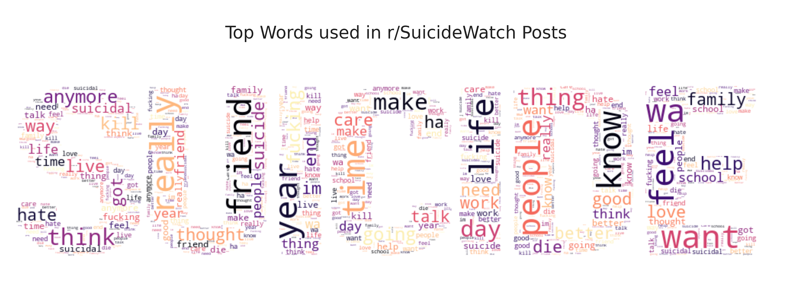
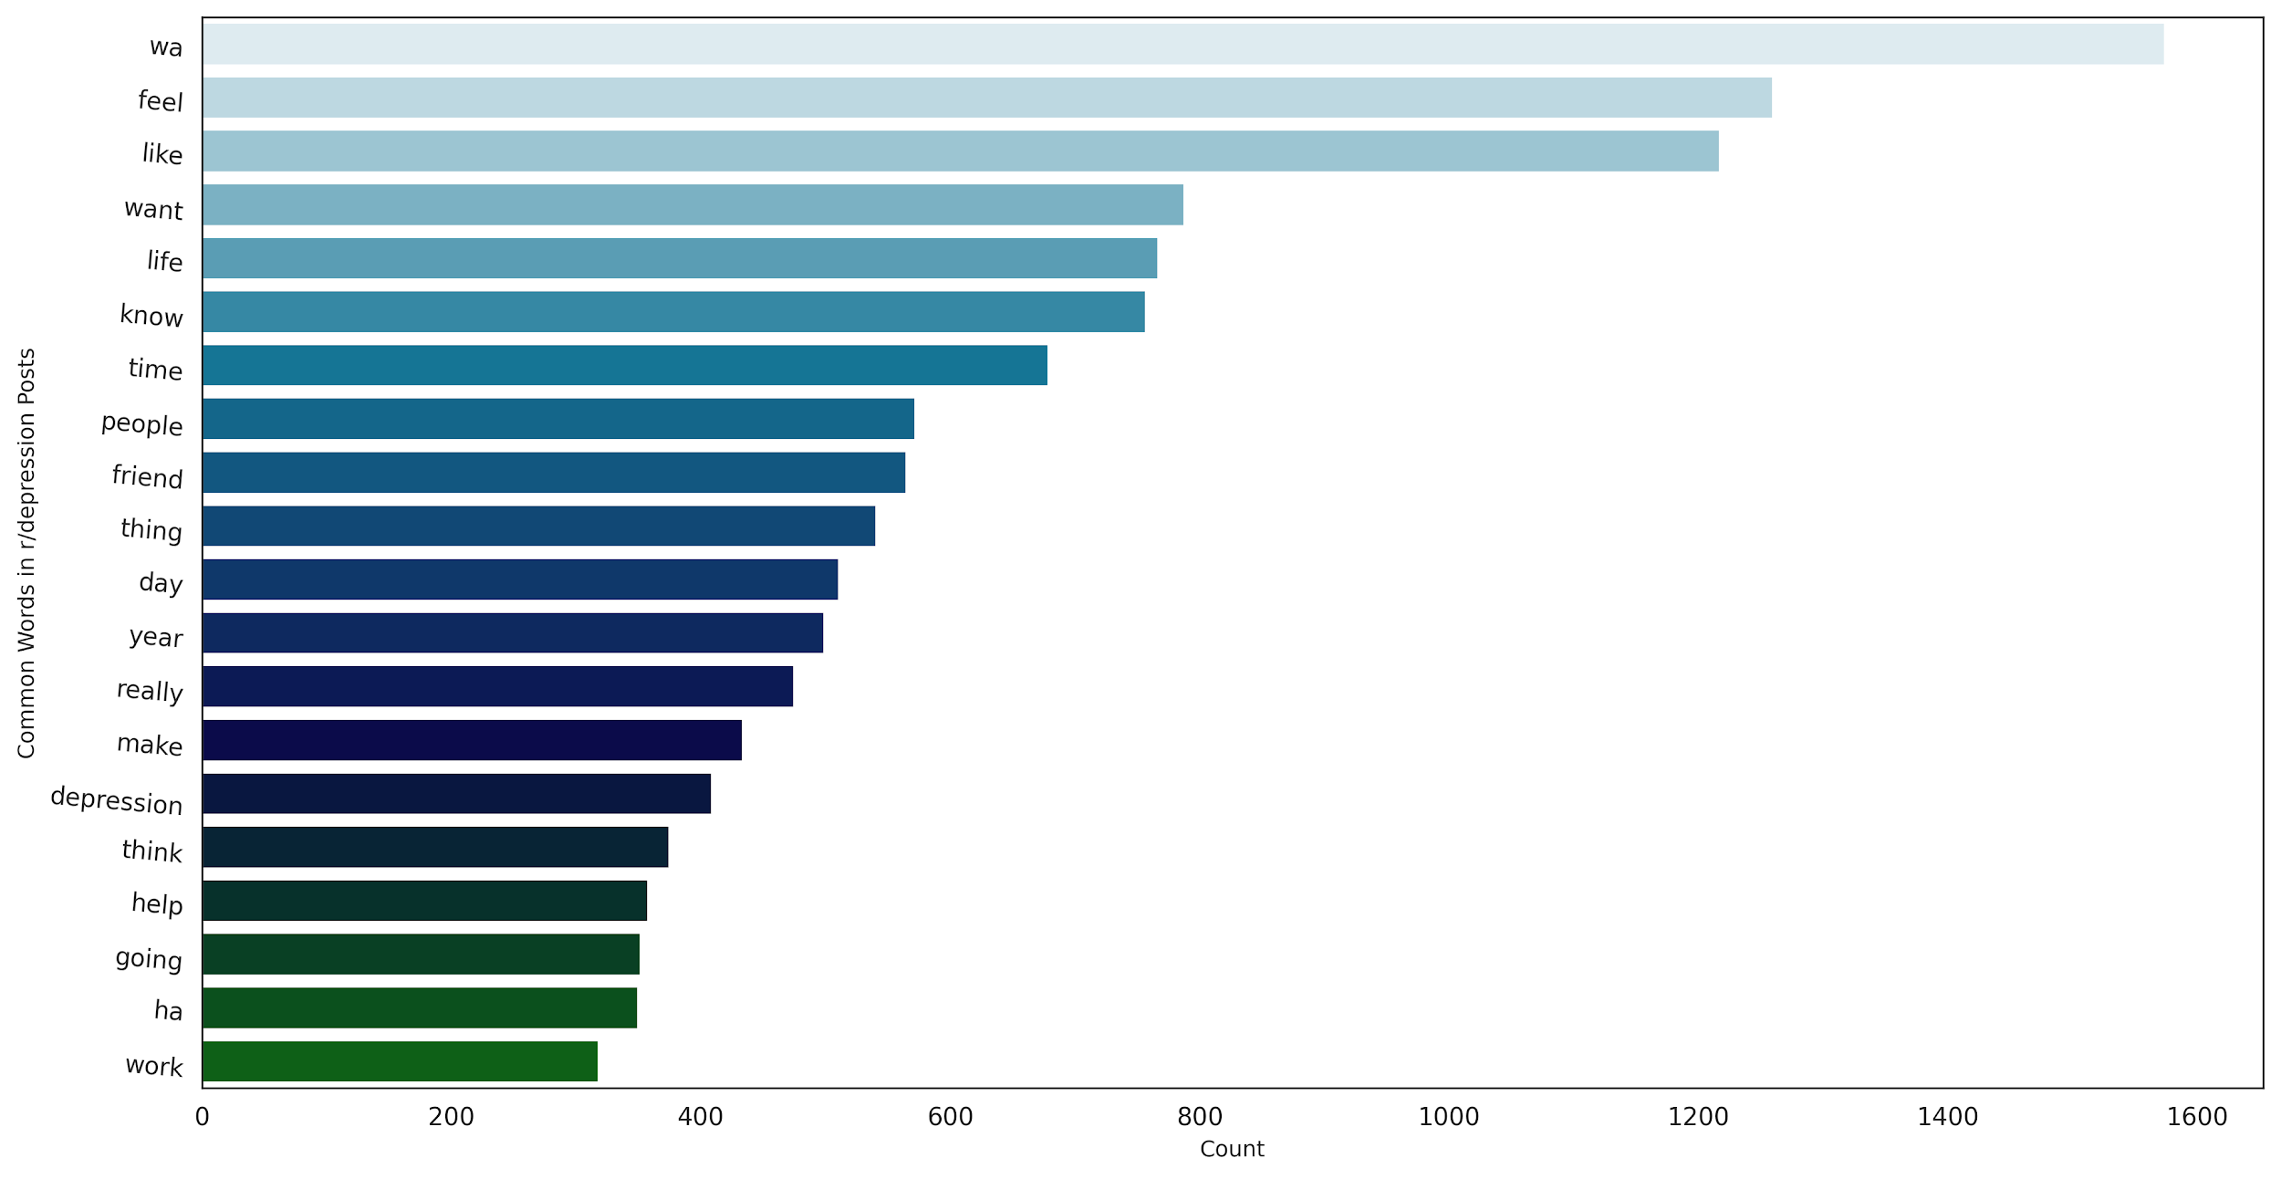
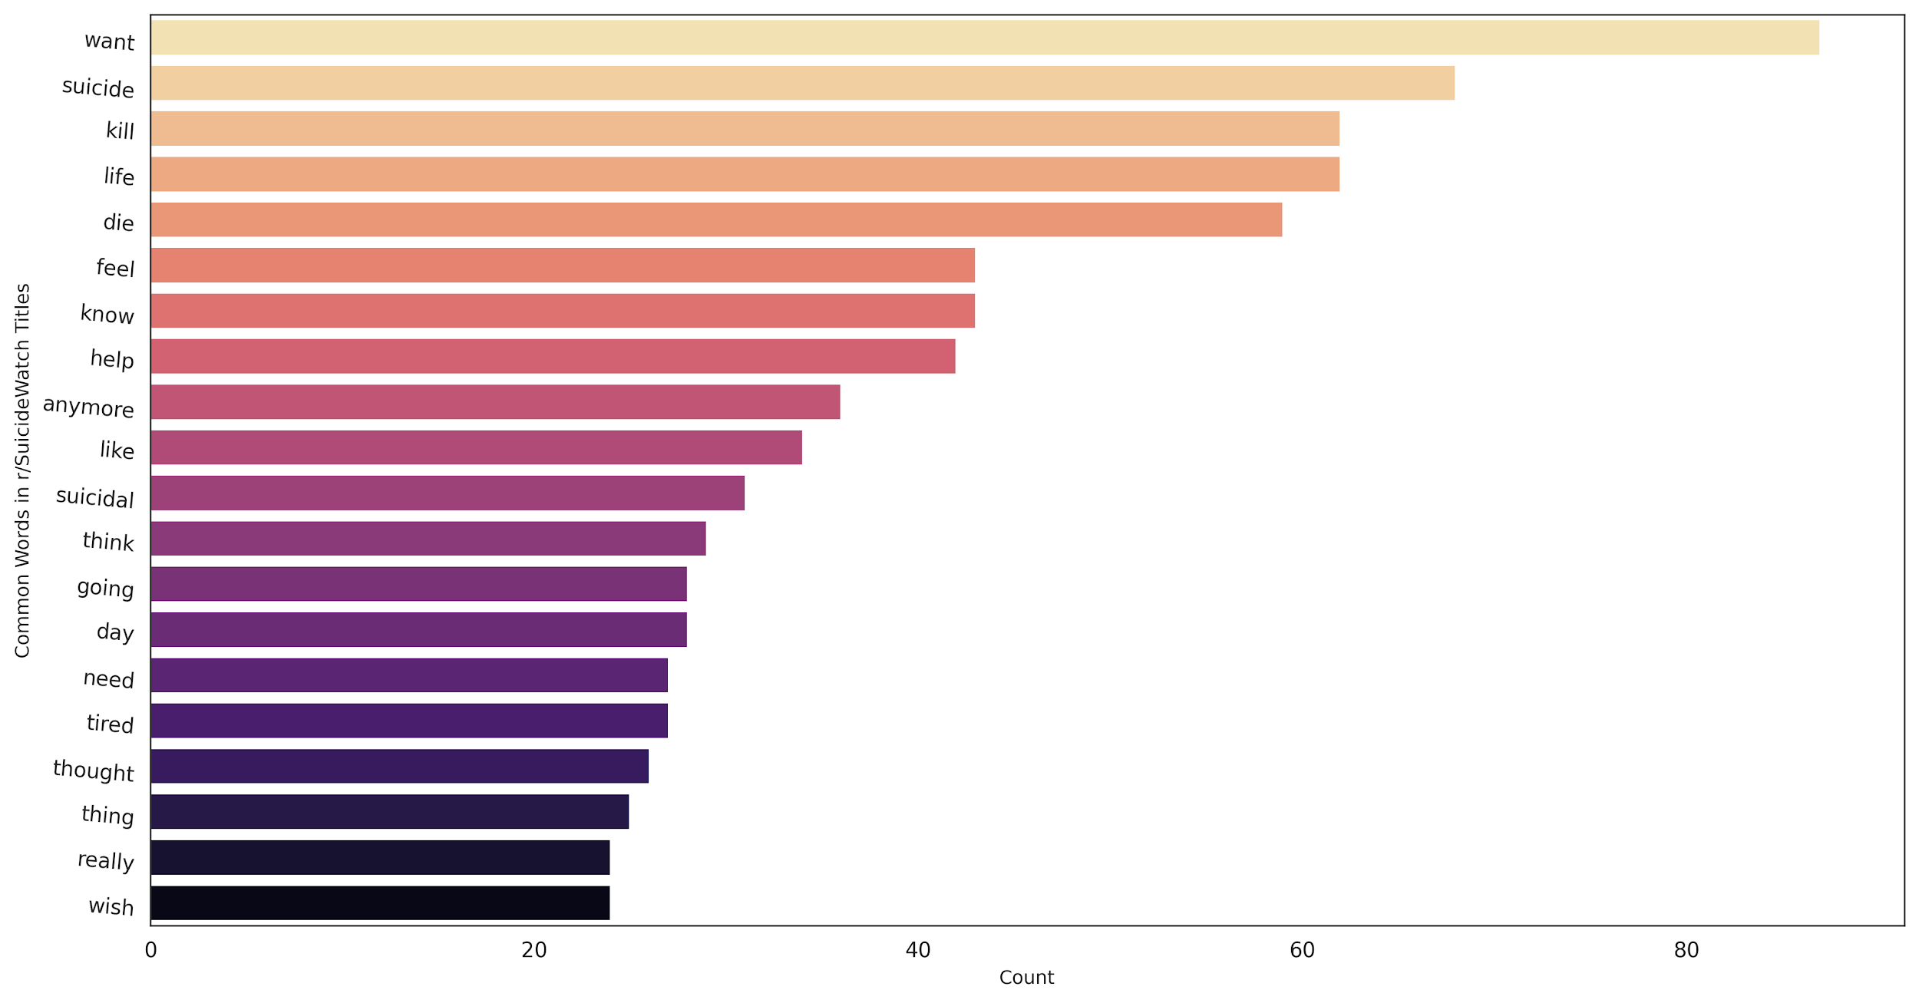
Data cleaning and Exploratory Data Analysis
Cleaned all selected features by tokenizing and lamentizing them. Author’s name sliced using Word Ninja.
Word Cloud of top words used in post . Feature extraction using Tokenizer and plotted using Seaborn and Matplotlib

Slide 5
Models used:
TFIDFVectorizer + Logistic Regression
2. TFIDFVectorizer + Multinomial Naive Bayes
Pipeline class from SKLearn library used to run multiple models simultaneously in a pipeline.
Parameters of main focus:
High ROC area under curve: Ability to identify true positives and true negatives with good accuracy
High Sensitivity: Ratio of correctly identified suicide cases to total number of suicide cases.
Less False Negatives: These are number of cases that our model identified as non-suicidal but it actually was a suicidal case.
High accuracy on testing data.

Slide 6
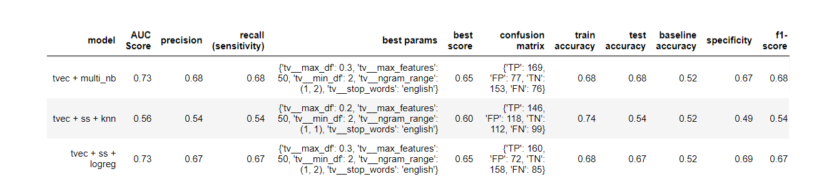
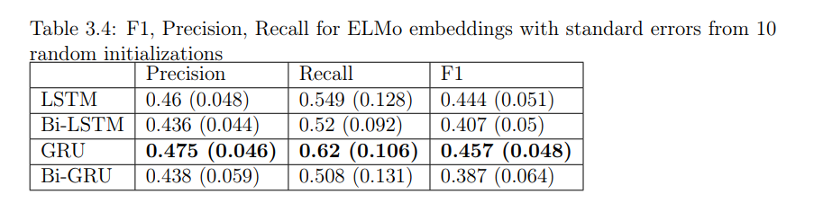
Model performances and accuracy comparison
Models and accuracy found in thesis

Slide 7
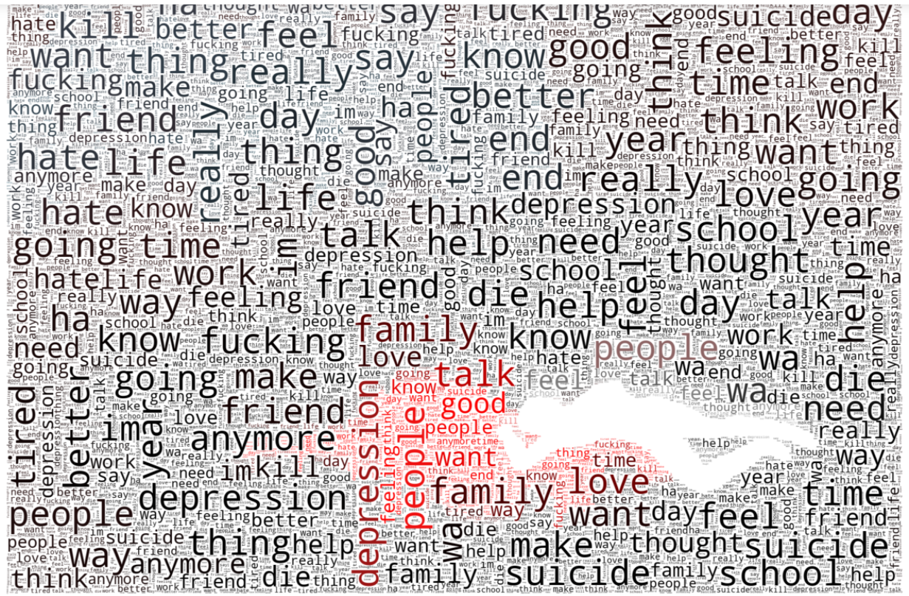
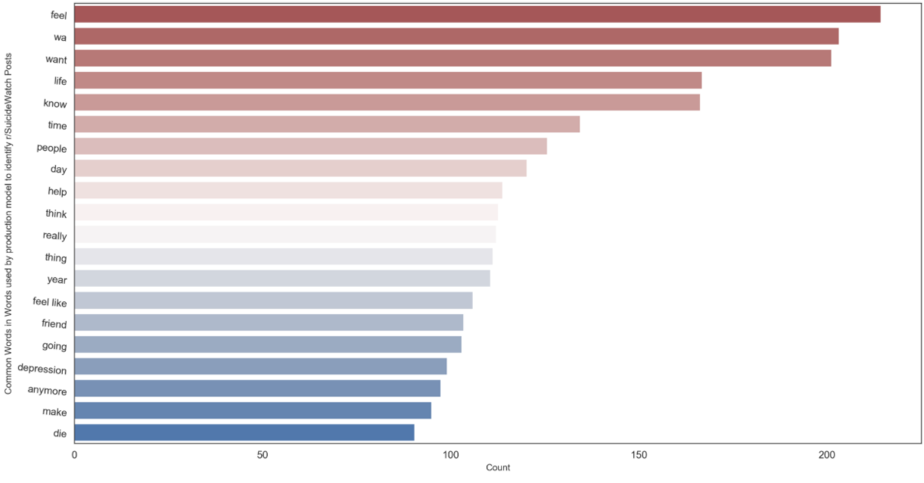
Top words used to identify suicidal cases(using Word Cloud library)
Bar plot for comparing frequency of top words

Slide 8
Using Victorias Data
Seven month after her passing , Victoria’s mother discovered a digital diary that she had kept in her laptop.
Contains detailed entries about her life and her thought process about suicide.
Applying our model to Victoria’s writings allows us see if our model -trained on data from online communities - would generalise well to an unseen test set.
Using social psychologist Roy theory , Bering mapped different parts of her diary to six different stages from
“falling short of expectations”: stage 1 to
“high-self-awareness” : stage-3 and to
the final stage of “disinhibition”

Slide 9
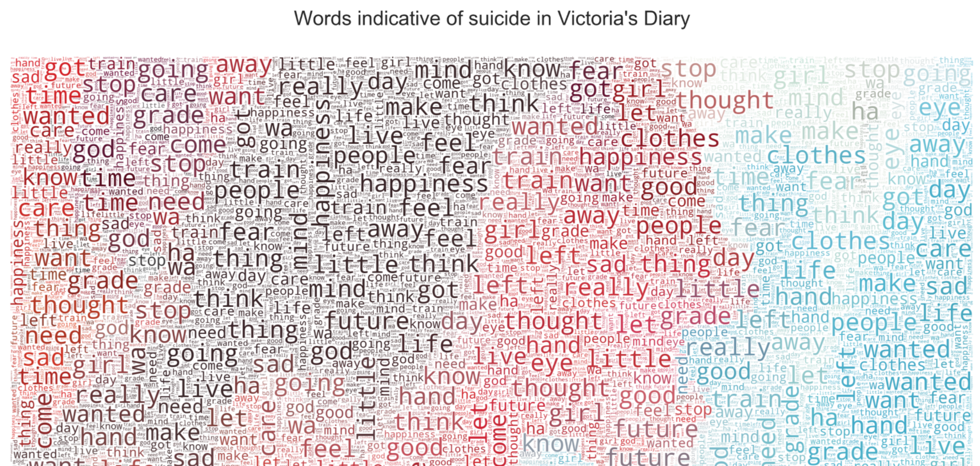
Using Victorias Data
TfidfVectorizer - Transforms text to feature vectors that can be used as input to estimator.
Result

Slide 10
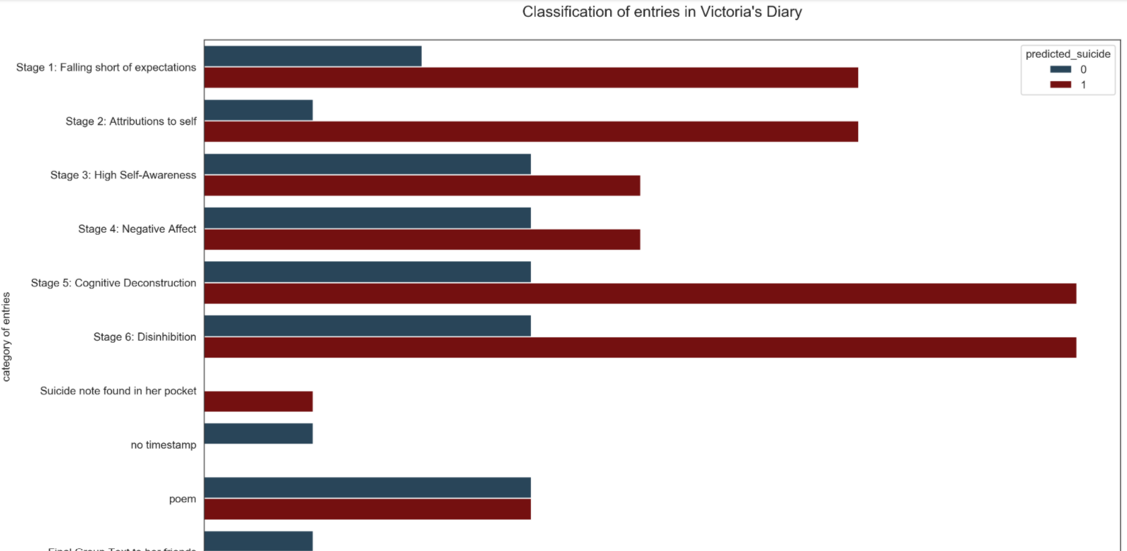
Result

